Slide 1
Simplifications of
Context-Free Grammars

Slide 2
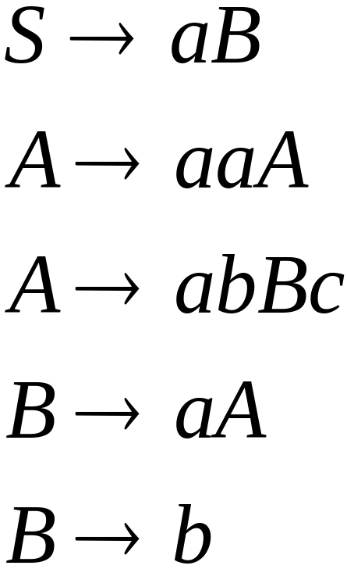
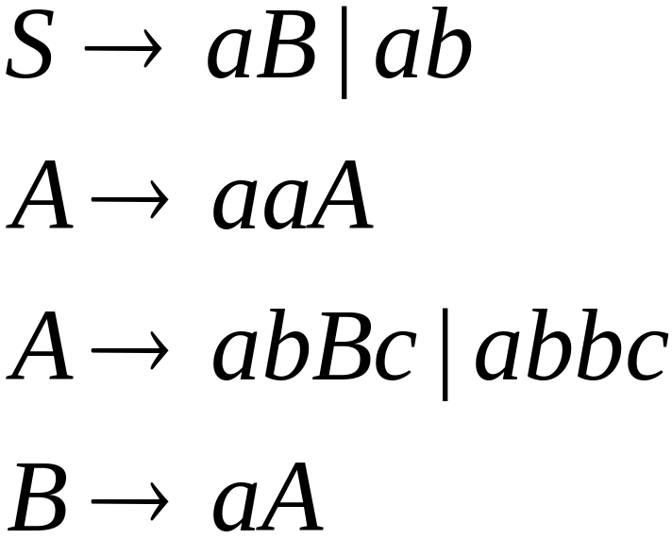

A Substitution Rule
Equivalent
grammar
Substitute

Slide 3


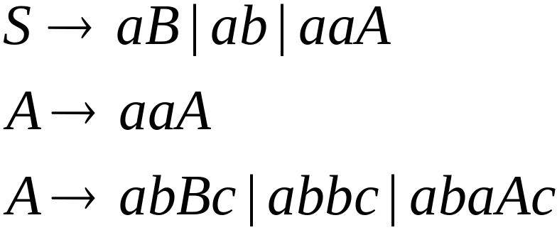
Substitute
Equivalent
grammar

Slide 4
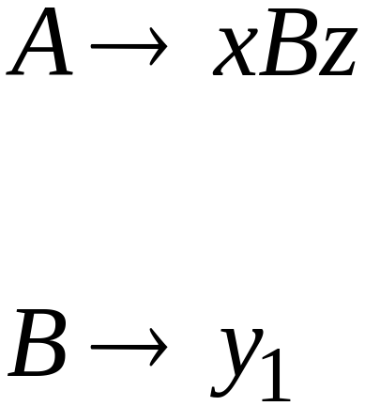
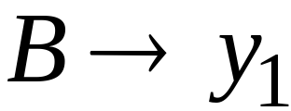
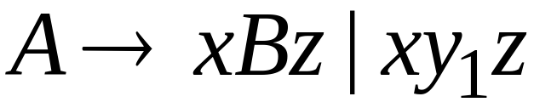
In general:
Substitute
equivalent
grammar

Slide 5
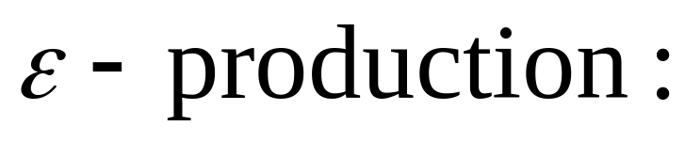
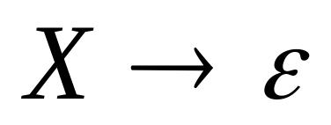
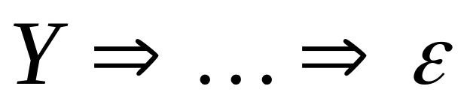
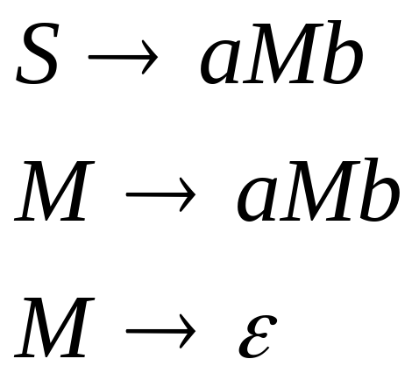
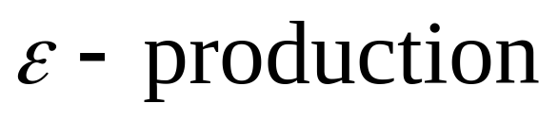
Nullable Variables
Nullable Variable:
Example:
Nullable variable

Slide 6
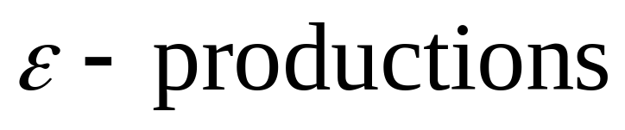

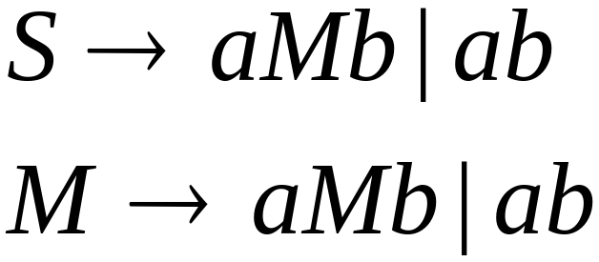
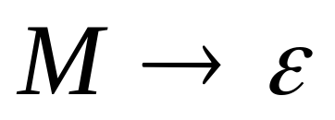
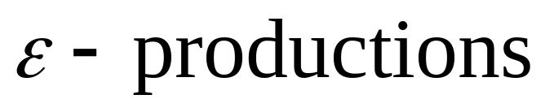
Removing
Substitute
After we remove all the
all the nullable variables disappear
(except for the start variable)

Slide 7

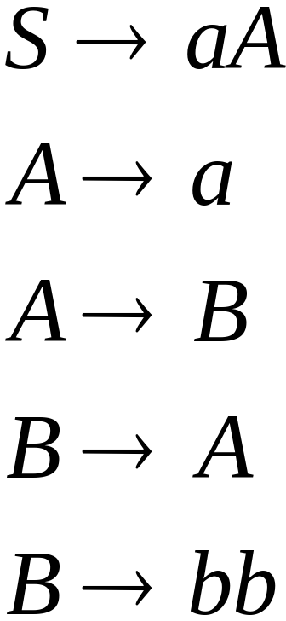
Unit-Productions
Unit Production:
(a single variable in both sides)
Example:
Unit Productions

Slide 8
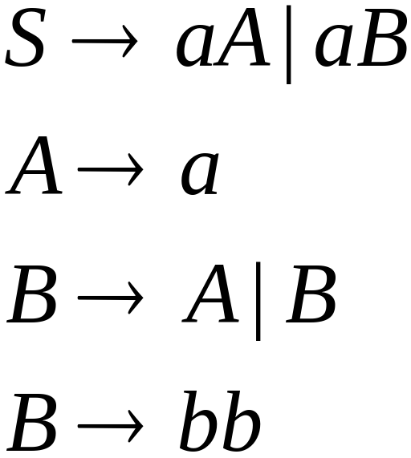

Removal of unit productions:
Substitute

Slide 9

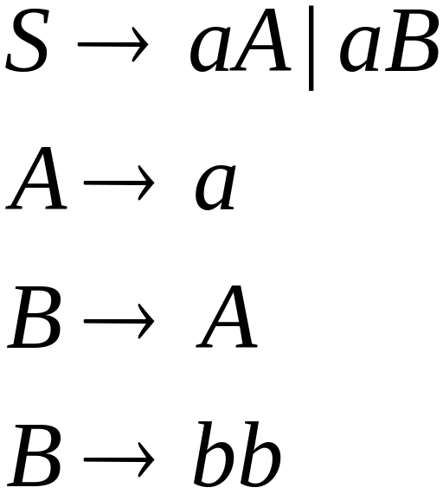

Unit productions of form
can be removed immediately
Remove

Slide 10
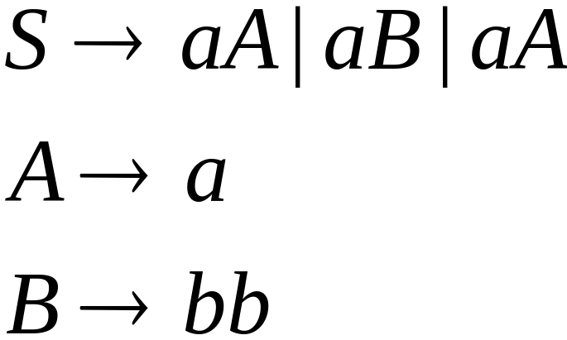

Substitute

Slide 11
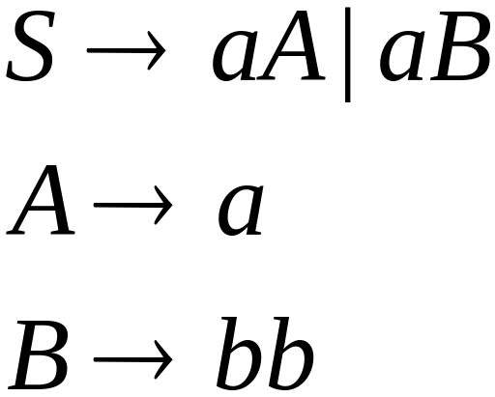
Remove repeated productions
Final grammar

Slide 12
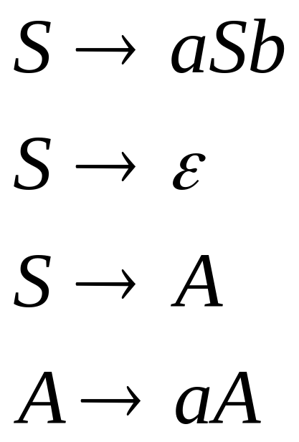
Useless Productions
Useless Production
Some derivations never terminate...

Slide 13
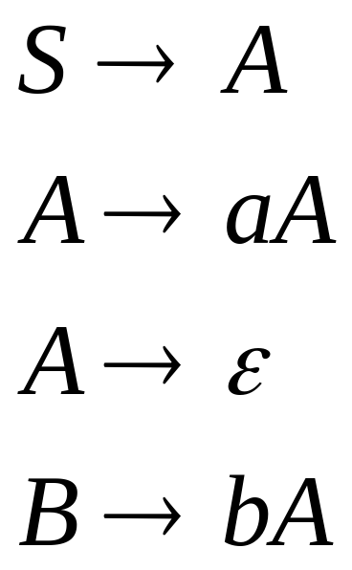
Another grammar:
Useless Production
Not reachable from S

Slide 14

In general:
If there is a derivation
consists of
terminals
Then variable is useful
Otherwise, variable is useless

Slide 15

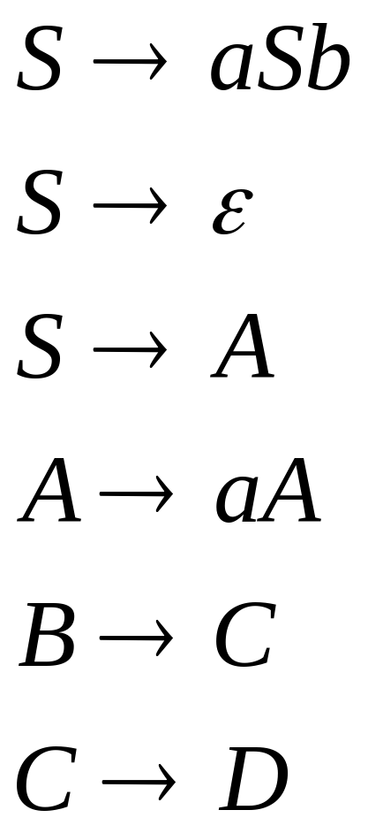
A production is useless
if any of its variables is useless
Productions
Variables
useless
useless
useless
useless
useless
useless
useless

Slide 16
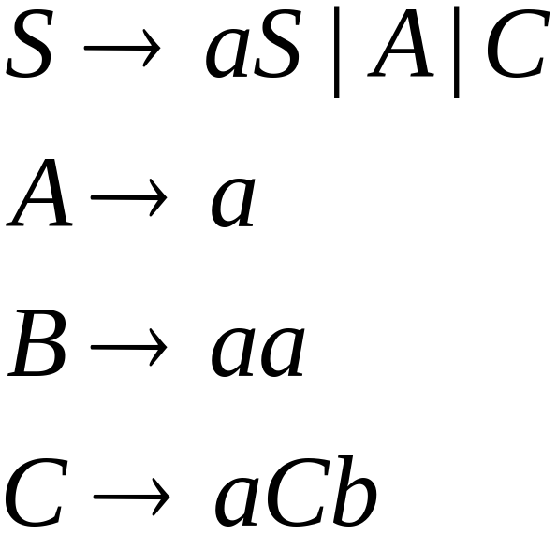
Removing Useless Variables and Productions
Example Grammar:

Slide 17

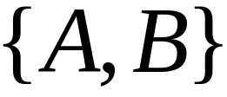
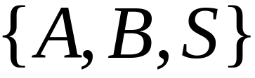
First:
find all variables that can produce
strings with only terminals or
(possible useful variables)
Round 1:
(the right hand side of production
that has only terminals)
Round 2:
(the right hand side of a production
has terminals and
variables of previous round)
This process can be generalized

Slide 18
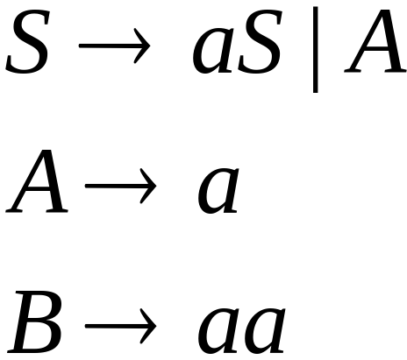
Then, remove productions that use variables
other than

Slide 19




Second:
Find all variables
reachable from
Use a Dependency Graph
where nodes are variables
unreachable

Slide 20
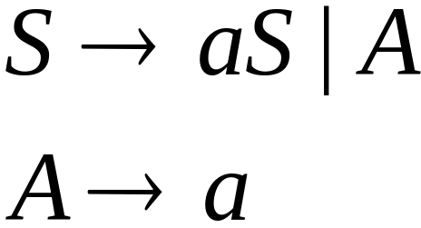
Keep only the variables
reachable from S
Final Grammar
Contains only
useful variables

Slide 21
Removing All
Step 1: Remove Nullable Variables
Step 2: Remove Unit-Productions
Step 3: Remove Useless Variables
This sequence guarantees that
unwanted variables and productions
are removed

Slide 22
Normal Forms for
Context-free Grammars

Slide 23


Chomsky Normal Form
Each production has form:
or
variable
variable
terminal

Slide 24
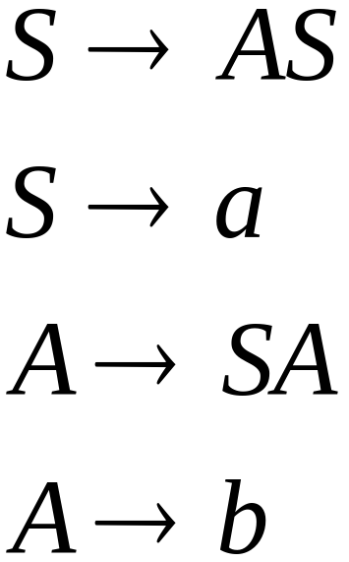
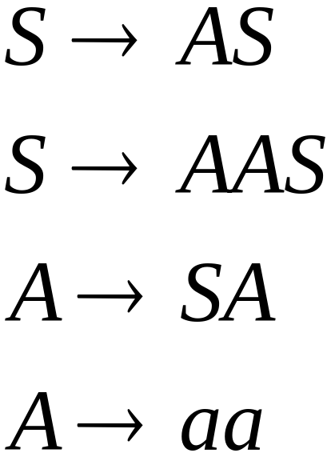
Examples:
Chomsky
Normal Form
Not Chomsky
Normal Form

Slide 25
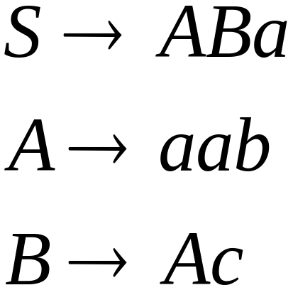
Conversion to Chomsky Normal Form
Example:
Not Chomsky
Normal Form
We will convert it to Chomsky Normal Form

Slide 26
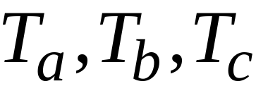
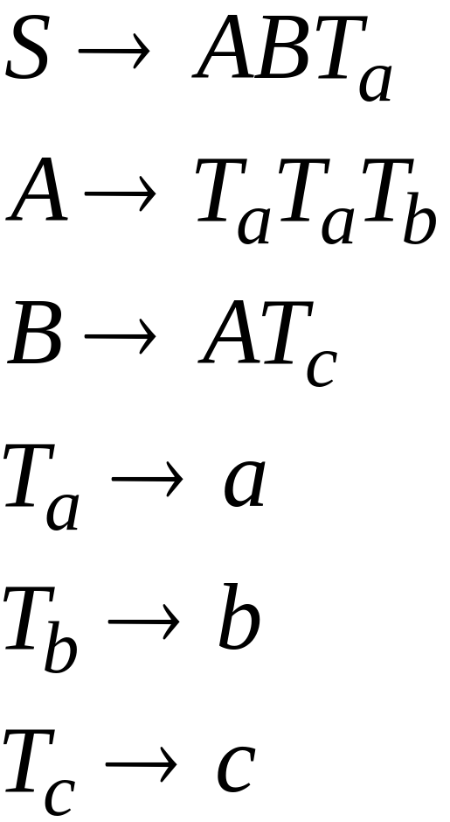
Introduce new variables for the terminals:

Slide 27

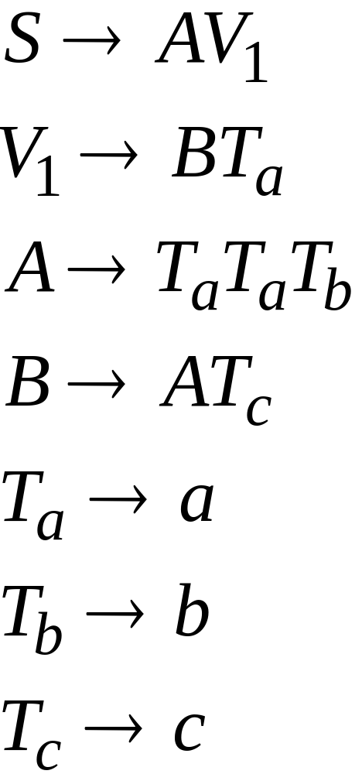
Introduce new intermediate variable
to break first production:

Slide 28
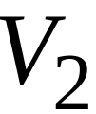
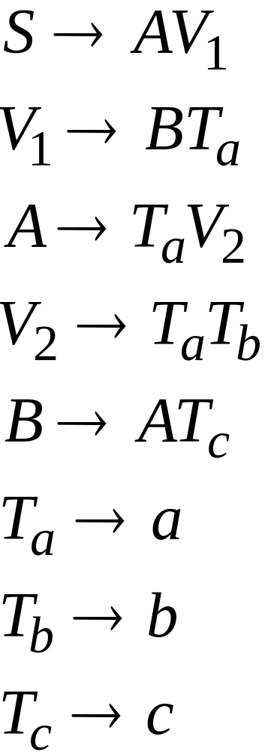
Introduce intermediate variable:

Slide 29
Final grammar in Chomsky Normal Form:
Initial grammar

Slide 30

In general:
From any context-free grammar
(which doesn’t produce )
not in Chomsky Normal Form
we can obtain:
an equivalent grammar
in Chomsky Normal Form

Slide 31
The Procedure
First remove:
    Nullable variables
    Unit productions
(Useless variables optional)

Slide 32


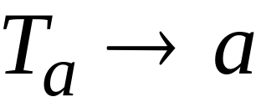
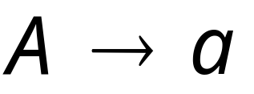
Then, for every symbol :
New variable:
Add production
In productions with length at least 2
replace with
Productions of form
do not need to change!

Slide 33
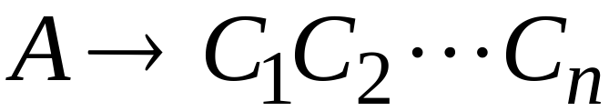
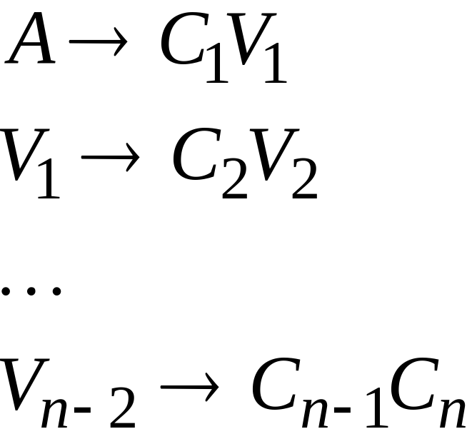
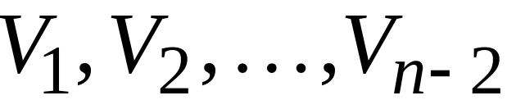
Replace any production
with
New intermediate variables:

Slide 34

Observations
Chomsky normal forms are good
for parsing and proving theorems
It is easy to find the Chomsky normal
form for any context-free grammar
(which doesn’t generate )

Slide 35
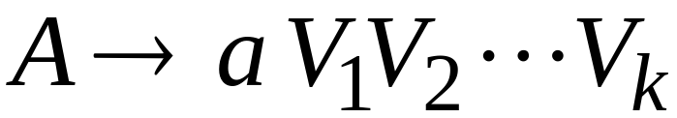

Greinbach Normal Form
All productions have form:
symbol
variables

Slide 36
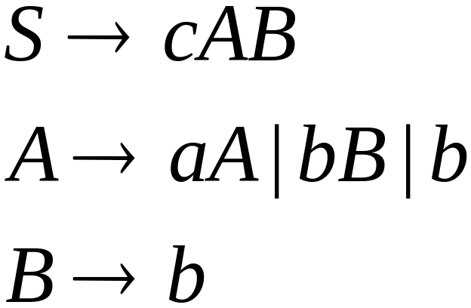
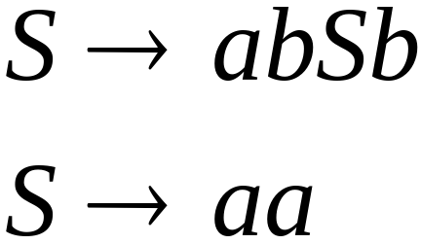
Examples:
Greinbach
Normal Form
Not Greinbach
Normal Form

Slide 37
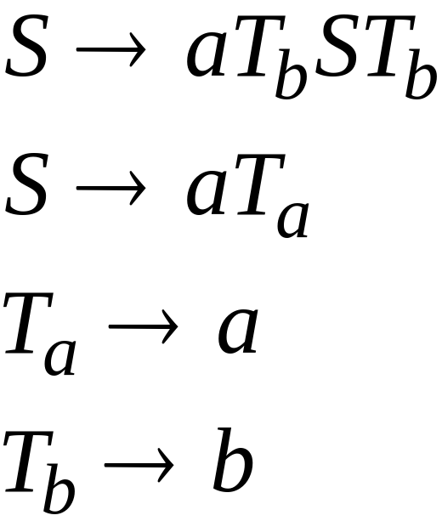
Conversion to Greinbach Normal Form:
Greinbach
Normal Form

Slide 38
Observations
Greinbach normal forms are very good
for parsing strings (better than Chomsky Normal Forms)
However, it is difficult to find the
Greinbach normal of a grammar

